Slide 1

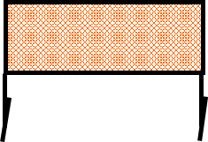
 | Renton Fish and Game Club 2019 Series Match Bay 2 Which Hole? Course Designer: Dave McClure
START POSITION: Standing outside the shooting area, toes touching marks, wrists below belt, facing squarely downrange. Gun loaded and holstered. PCC: Standing outside the shooting area, toes touching marks, facing squarely downrange. Gun loaded, stock touching belt, muzzle pointed squarely downrange.
STAGE PROCEDURE: At start signal, engage targets as they become visible from within the shooting area. |  | SCORING: Comstock, 34 rounds, 170 points TARGETS: 17 metric, 1 NS SCORED HITS: Best per paper START-STOP: Audible - Last shot
Shooting area
Shooting area
Shooting area
x x

